Slide 1
Introduction to Artificial Intelligence
By Abeeha Sattar

Slide 2

What makes Humans Intelligent?
The ability to:
Perceive
Understand
Predict
Manipulate
The ability to:
Think
Learn
Make Decisions

Slide 3
Intelligent Machines
If a machine is able to do exactly that, would it be an intelligent machine?
Well… maybe? (Turing Test)

Slide 4
What is AI?
Algorithms enabled by…
… Constraints exposed by…
… Representations that support…
… Models targeted at…
  Thinking
  Perception, and
  Action
  Credits: Patrick H. Winston

Slide 5



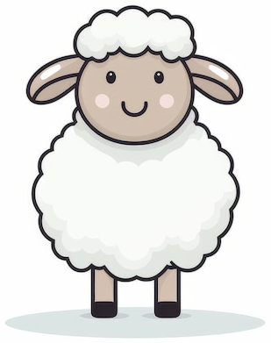


Representation Example:
Think of the puzzle… Farmer, Sheep, Wolf and Cabbage
What ways can you think of to represent it?

Slide 6
Solving the Puzzle – Constraints!
Finding out all combinations – 2^4 – 16 combinations:
{
}
Find out the constraints:
Write an algorithm…

Slide 7



The Rumpelstiltskin Principle
Knowing the true name or nature of something grants power over it
What are these called?
Ferrule, Tittle, Aglet (what’s what?)

Slide 8
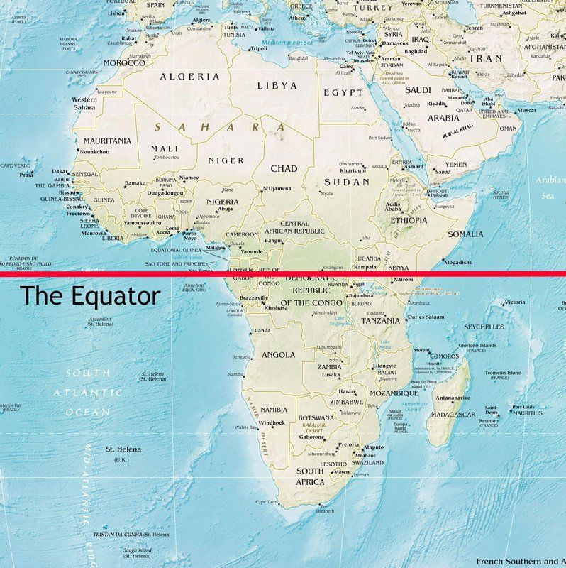

Question – How many Countries in Africa are on the Equator?

Slide 9
Let’s think about how you came up with the answer
Step 1: Audio Cue → My question
Step 2: ???
???
Step ?: Profit (…Or not – Can we make a machine do this?)

Slide 10
Driving a Car – As a Human
Audio Cues (honking, etc)
Visual Cues (mirror views, etc)
Memory (rules, what to push, when to turn, etc)
Execution (performing actions on the steering wheel, brakes, etc)
Using all of the above to drive over some time, results in experience.

Slide 11
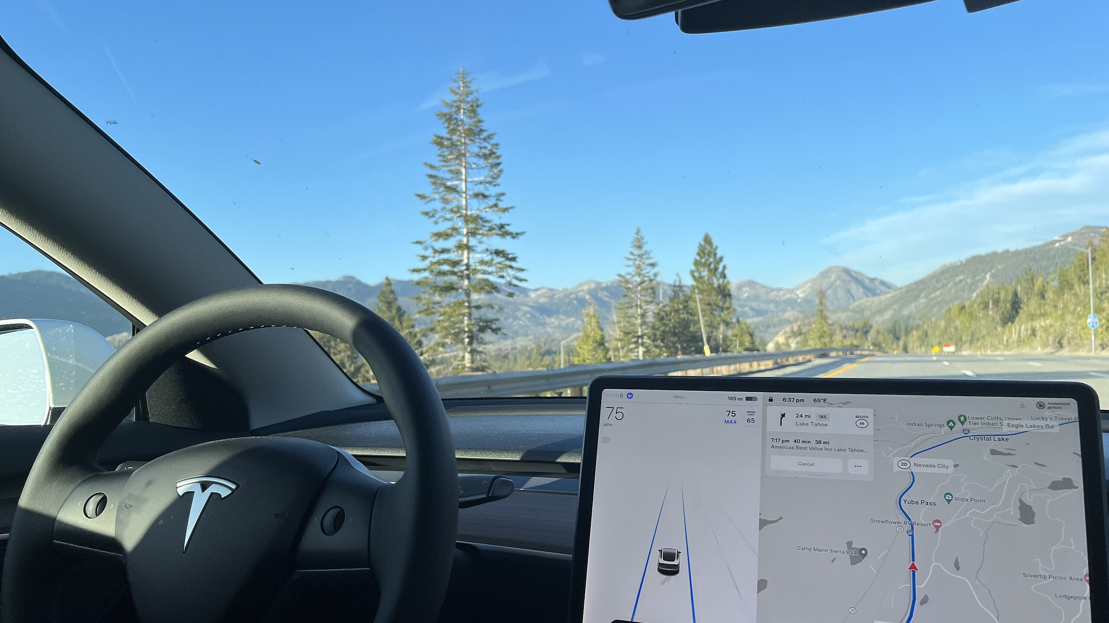
Self-Driving Cars
Training Data
Computer
Self-Driving Cars

Slide 12
AI – The Textbook Definition
“The study and design of intelligent agents, where an intelligent agent is a system that perceives its environment and takes actions that maximize its chances of success.”

Slide 13
More on AI
It is the science and engineering of making intelligent machines, especially intelligent computer programs. It is related to the similar task of using computers to understand human intelligence, but AI does not have to confine itself to methods that are biologically observable.
Views of AI fall into four categories:
Thinking Humanly
Acting Humanly
Thinking Rationally
Acting Rationally

Slide 14
The Four Schools of Thought
Rational
Thinking Rationally
Acting Rationally
Thinking Humanly
Acting Humanly
Using formal logic and symbolic reasoning to solve problems, rooted in Greek philosophy
Designing agents that act optimally to achieve the best possible outcome, given available information.
Thought
Behavior
Creating machines that can behave indistinguishably from humans, as measured by the Turing Test
Building systems that mimic human thought processes, drawing from cognitive science.
Human

Slide 15
Acting humanly: The Turing Test Approach
A computer passes the test if a human interrogator, after posing some written questions, cannot tell whether the written responses come from a person or from a computer.
For that, the computer would need the following capabilities:
natural language processing to communicate successfully in a human language;
knowledge representation to store what it knows or hears;
automated reasoning to answer questions and to draw new conclusions;
machine learning to adapt to new circumstances and to detect and extrapolate patterns.

Slide 16
The “Total Turing Test”
Other researchers have proposed a total Turing test, which requires interaction with objects and people in the real world.
To pass the total Turing test, a robot will need
computer vision and speech recognition to perceive the world;
robotics to manipulate objects and move about.

Slide 17
Thinking humanly: The Cognitive Modeling Approach
To say that a program thinks like a human, we must know how humans think. We can learn about human thought in three ways:
Introspection — trying to catch our own thoughts as they go by;
psychological experiments — observing a person in action;
brain imaging — observing the brain in action.
Requires detailed matching of computer behavior and timing to detailed measurements of human subjects gathered in psychological experiments

Slide 18
Thinking Rationally:
The “Laws of Thought” Approach
Formalize “correct” reasoning using a mathematical model (e.g. of deductive reasoning/logical
conclusion).
Socrates is a man
All men are mortal
Conclusion: Socrates is mortal
Logic, however is based on certainty, which is not feasible in real world.
The theory of probability helps fill this gap.

Slide 19
Acting rationally:
The Rational Agent Approach
An agent is just something that acts
Computer agents are expected to:
  operate autonomously,
  perceive their environment,
  persist over a prolonged time period,
  adapt to change,
  and create and pursue goals
A rational agent is one that acts so as to achieve the best outcome or, when there is uncertainty, the best expected outcome.

Slide 20
The History of AI
1950: Turing
  Turing's "Computing Machinery and Intelligence“
1956: birth of AI
  Dartmouth meeting: "Artificial Intelligence“ name adopted
1950s: initial promise
  Early AI programs, including
  Samuel's checkers program
  Newell & Simon's Logic Theory – GPS – General Problem Solver
1986: Rise of machine learning
  Neural networks return to popularity
  Major advances in machine learning algorithms and applications
1990: Role of uncertainty
  Bayesian networks as a knowledge representation framework
1995: AI as Science
  Integration of learning, reasoning, knowledge representation
  AI methods used in vision, language, data mining, etc

Slide 21
The Very First Chatbot
The first chatbot ever was developed by MIT professor Joseph Weizenbaum in the 1960s.
https://www.masswerk.at/elizabot/

Slide 22
DeepSeek – Oh, wrong one! Deep Blue!
A chess playing supercomputer(of its time)
It first played world champion Garry Kasparov in a six-game match in 1996, where it won one, drew two, and lost three games.
In 1997, it defeated Kasparov by winning two games and drawing three, in a 6-game rematch.

Slide 23
Let’s differentiate between AI and Others
Artificial Intelligence (AI) – The umbrella term for techniques that allow machines to be smart
Machine Learning (ML) – Allows computers to learn from examples without being explicitly programmed. Uses different tools and algorithms to learn from data.
Artificial Neural Networks – Computational Models with interconnected artificial neurons.
Deep Learning (DL) – Uses algorithms which are inspired by how human brains work. Artificial Neural Networks with more layers, or human brain inspired algorithms.
Generative AI – A branch of Deep Learning focused on “creating new” content.
Agentic AI – Autonomous AI systems that can independently set goals, plan, reason, and execute complex, multi-step tasks with minimal human intervention, acting proactively rather than just reactively like traditional AI

Slide 24
Machine Learning Flow
Collect Data
Data Cleaning and Feature Engineering
Building a model with the correct algorithm
Evaluate the model
Deploy the model

Slide 25
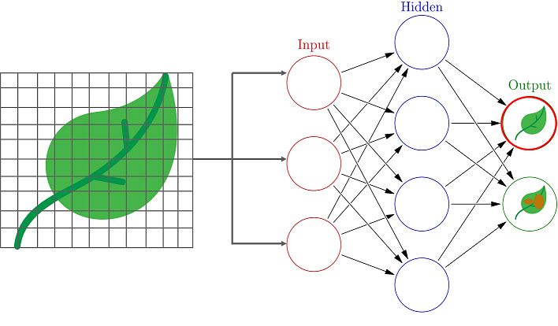
Neural Networks
Image Credits: https://www.edureka.co/blog/what-is-a-neural-network/

Slide 26
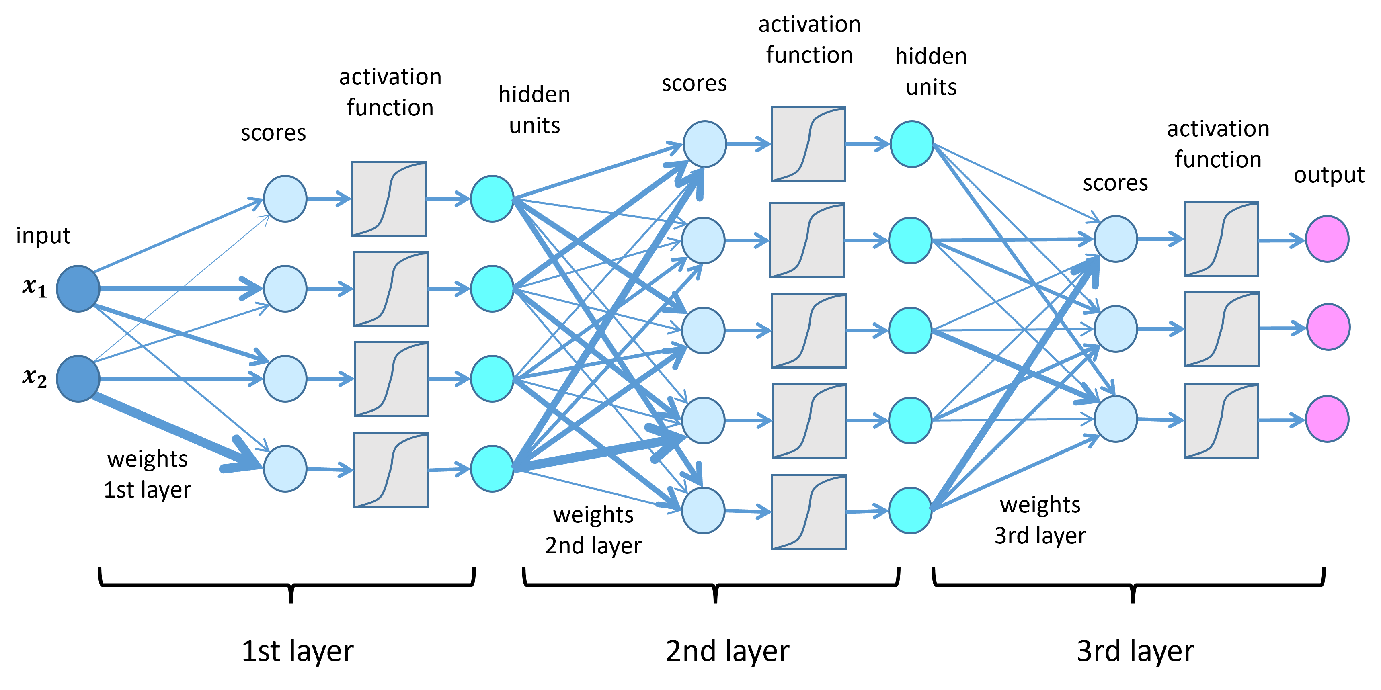
Deep Learning
Image Credits: https://lamarr-institute.org/blog/deep-neural-networks/

Slide 27
Advances in AI Over Time…
Autonomous planning and scheduling: NASA’s Remote Agent program became the first on-board autonomous planning program to control the scheduling of operations for a spacecraft.
Machine translation: Online machine translation systems now enable the reading of documents in over 100 languages, including the native languages of over 99% of humans, and render hundreds of billions of words per day for hundreds of millions of users.
Speech recognition: In 2017, Microsoft showed that its Conversational Speech Recognition System had reached a word error rate of 5.1%

Slide 28
Advances in AI Over Time…
Recommendations: Companies such as Amazon, Facebook, Netflix, Spotify, YouTube, Walmart, and others use machine learning to recommend what you might like based on your past experiences and those of others like you
Medicine: AI algorithms now equal or exceed expert doctors at diagnosing many conditions, particularly when the diagnosis is based on images.
Climate science: A team of scientists won the 2018 Gordon Bell Prize for a deep learning model that discovers detailed information about extreme weather events that were previously buried in climate data.

Slide 29
Advances in AI Over Time…
And of course, not present in the book, but now we have generative AI…

Slide 30
Risks of AI – Let’s Discuss
Surveillance and persuasion – collecting your data, controlling data flow to modify human reaction or behavior
Biased decision making – AI sorting out resumes or applications
Impact on employment – good or bad?
Safety-critical applications – in self driving cars, or in the medical field
Cybersecurity – blackmail and phishing attacks

Slide 31
Risk of… GenAI… (woah)
Let’s discuss

Slide 32
Fin.
>:3

